Slide 1
Tutorial 4 Extra Slides
First half revision By Jeremy Lim jeremylim@u.nus.edu

Slide 2
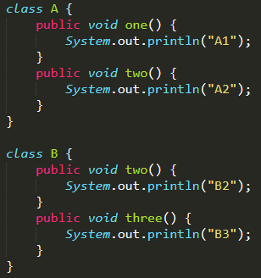
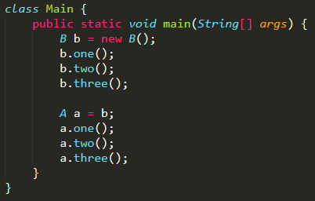
Polymorphism
For each line, is it valid and if so, what is the output?

Slide 3

Polymorphism
For each line, is it valid and if so, what is the output?
A’s Methods
one()
two()
A’s Implementation
one()
two()
Output: A1 B2 B3
B’s Methods
one()
two()
three()
B’s Implementation
two()
three()

Slide 4

Polymorphism
For each line, is it valid and if so, what is the output?
A’s Methods
one()
two()
A’s Implementation
one()
two()
“Output”: A1 B2 *compilation error*
B’s Methods
one()
two()
three()
B’s Implementation
two()
three()

Slide 5
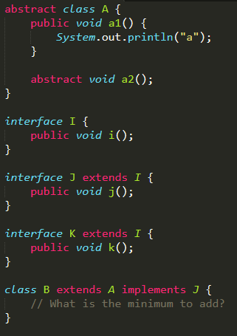
Interfaces & Abstract classes
What is the minimum code to add?

Slide 6
Interfaces & Abstract classes
What is the minimum code to add?
B can be of type B, A, I, J

Slide 7
Interfaces and Abstract classes
Class
Class with inheritance
Abstract Class
Interface
- What you see is what you get
- Get what you see
+ all non-private methods and variables of ancestors
- Cannot be directly used, must be extended
- Force some methods to be implemented by children
- Force all methods to be implemented by children
- Cannot contain object variables
- All declared variables are static

Slide 8
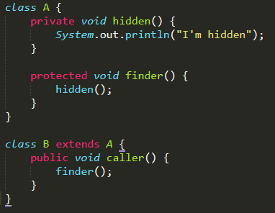
Class with Inheritance
You might not have thought of this:
B b = new B();
b.caller();
Will this work?

Slide 9
Class with Inheritance
Will this work?
Yes!
Private methods & variables can still be accessed by methods in the same class as it is implemented.

Slide 10
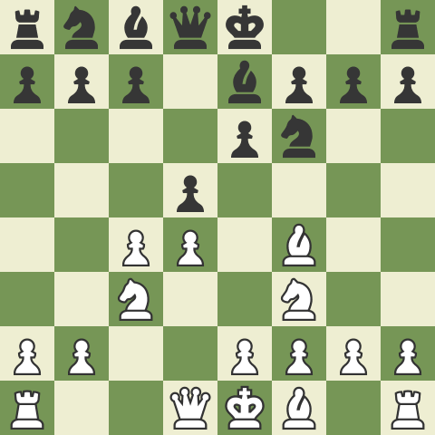
Abstract class
Scenario: Chess where all pieces only have one move
Example: Bishop can only move diagonally up

Slide 11
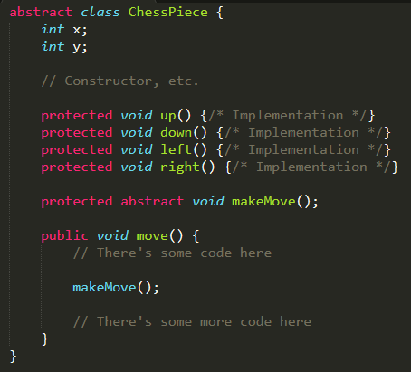
Abstract class
Given implementation of ChessPiece

Slide 12
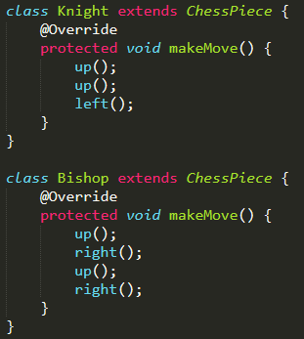
Abstract class

Slide 13
Generics
What is a List<Queue<List<Integer>>> ?
List of Queues of Lists of Integers

Slide 14
Generics
How about ArrayList<ArrayList<Integer>> ?
Like int[][] but not really.

